Slide 1
Conducting Surveys
RMSP

Slide 2
What Is a Survey?
A survey is a series of questions asked to a group of people in order to gain information
Information gathered can be facts, attitudes, feelings, beliefs
RMSP

Slide 3
Necessary Evil?
What people think of Surveys
  Annoying
  Intrusive
  Frustrating to use
  Ambiguous
  Boring
RMSP

Slide 4
Necessary Evil?
Bad Surveys = Bad Results
  Yield low response rates
  Unrepresentative samples
  High amount of incomplete surveys
RMSP

Slide 5
Necessary Evil?
But they do work?
  Yes - if designed right
  Especially when delivered over the web:
  Very Efficient
  Exponentially inexpensive
  Accurate Data Collection
RMSP

Slide 6
Surveys are Everywhere
Pop-up quick polls
Evaluations
On-line Product Registrations
Email Initiated Surveys
Product Downloads requiring survey
Election Exit Polls (very accurate!)
Even an Election is a type of survey
RMSP

Slide 7
Surveys Are a MEANS to an END
The goal is NOT to “do a survey”
The goal is to acquire data to make proper decisions
A survey is only one channel of information in support of that decision-making process
RMSP

Slide 8
Why Do a Survey?
The goal of any survey is to collect data which can be analyzed, and used to aid decisions
RMSP

Slide 9
The Survey Life Cycle
Plan the survey
Design the survey
Test the survey
Deploy the survey
Reporting
RMSP

Slide 10
Overview of Survey Process
Design (1)
Creation (7)
Collection (1)
Analysis/Reporting (1)
RMSP

Slide 11
Planning
Objectives:
What information do you need to define?
  How many will attend the Retirement Recognition and how many of this group will eat lunch.
What decisions will this information impact?
  How much space is needed for the Retirement Recognition and how many lunches are needed.
Who is the audience for the survey?
  Everybody in Extension
Who is the audience for the report?
  Organization Top Management
In what format is the report needed?
  Excel spreadsheet with names and numbers or head count
How will you deliver the survey to your audience?
  Email
RMSP

Slide 12
Design the Survey
Map out questions to help you gain the information needed to meet the survey objective
Question Types:
  Open:
    No pre-set selections – type in text, numbers – whatever is appropriate for the question.
    Open-ended questions – unstructured fill-in-the-blank types of questions.
    Good for gathering general information and revealing what is on the respondents’ minds
    Open-ended questions require a lot of time to analyze and are more readily open to misinterpretation.
  Closed:
    Choose from pre-set selections only
    Multiple choice, Yes/No, True/False (etc.)
    Choices are structured; respondents must choose from a scale or a series of options.
    Good for nailing down specific, numeric options, and they’re easier to analyze
    They may not offer enough choices and options for people to truly express their opinions
  Mixed:
    Combinations of closed and open (i.e. “Other – Please specify_________”)
RMSP

Slide 13
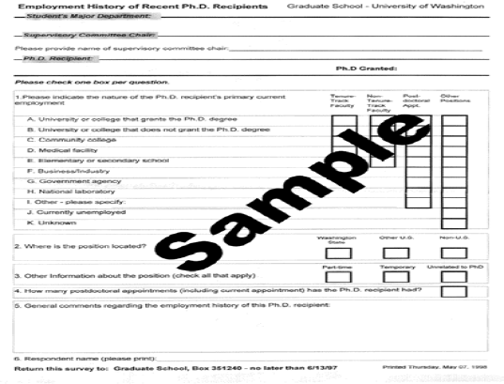
RMSP

Slide 14
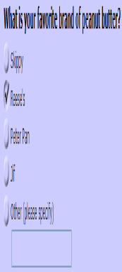
Choice-One Vertical Answer
RMSP

Slide 15
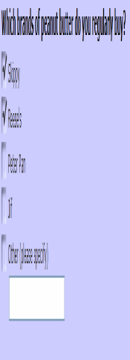
Choice – Multiple Answers Vertical
RMSP

Slide 16
Survey Deployment
is one of the last things done in any survey project.
Surveys cannot be deployed until
  the survey design has been tested,
  databases and tables have been tested, and
  the data has been checked to ensure that it is being properly collected.
  Once surveys have been designed and rigorously tested, they will be ready for deployment.
RMSP

Slide 17
Survey Deployment Methods
E-mail Invitation
  The invitation is computer generated
  E-mail addresses can be imported from GroupWise or a .txt file
  When a user finishes the survey, this user gets flagged in the database.
  When necessary, e-mail a second invitation. Users who are flagged will not get a reminder.
  Passwords, links, and instructions can be in the e-mail
E-Mail Survey
  The survey will be in the body of the e-mail
Print a paper copy of the survey
Handheld device, PDA
Post a link to your survey on the your county/department website.
RMSP

Slide 18
Reporting Results
Export data to other software applications
  Access
  Excel
  PowerPoint
Loading responses into a personal database
  From e-mail
  From a file (TSV, Tab Separated Value)
  Using entry screen for interviews or paper-based results
  From handheld device
RMSP

Slide 19
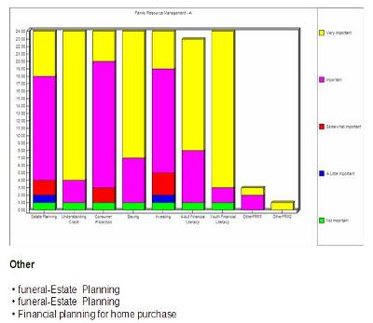
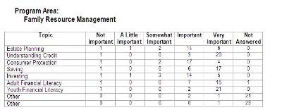
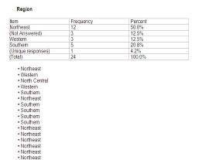
Report Example - Word
RMSP

Slide 20
Top-Ten Best Survey Practices
Best Practice #1:
Start with your objectives, not questions
RMSP

Slide 21
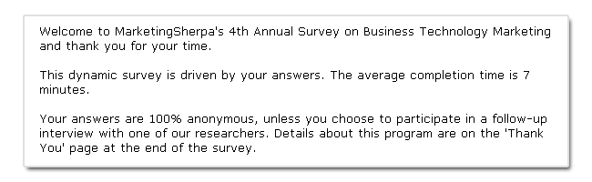
Best Practice #2:
Introduce Your Survey & How Long it Will Take
RMSP

Slide 22
Best Practice #3:
Include “Not Applicable” and “Don’t Know”
(especially on required questions)
Method: For all questions ask yourself, “Will this be applicable to everyone? How would I answer it? Could ‘don’t know’ be a possible answer?
RMSP

Slide 23
Best Practice #4:
Use clear and concise questions
and options
RMSP

Slide 24
Best Practice #5: Nice-to-knows Don’t Count
Best Practice #6:
Use branching and show/hide to shorten your survey’s appearance.
Best Practice #7:
Test your Survey
RMSP

Slide 25
Best Practice #8: After testing, do a “conceptual analysis”
Best Practice #9:
Use your survey results as an incentive.
Best Practice #10: Sample whenever your target audience is greater than 500*
RMSP

